Slide 1
Analysis and Exploration of Satellite Orbital Relationships
Aleksander Sekowski, Charlie King
04/18/2023

Slide 2
Introduction
Dataset and main concepts
Current trends in orbit activity
Segmentation of satellite market
Cluster analysis
Orbit visualization
Conclusions
Future Work
04/18/2023

Slide 3
Dataset and main concepts
Source: Union of Concerned Scientists
Union of Concerned Scientists
UCS Satellite Database
https://www.ucsusa.org/media/11492
04/18/2023

Slide 4
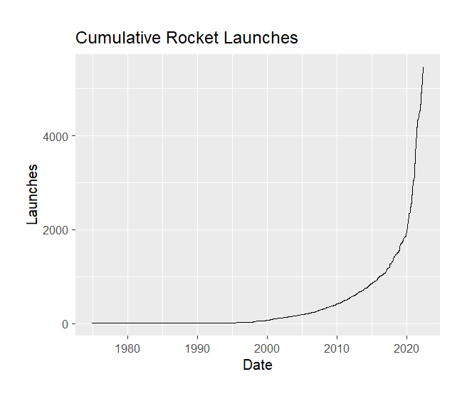
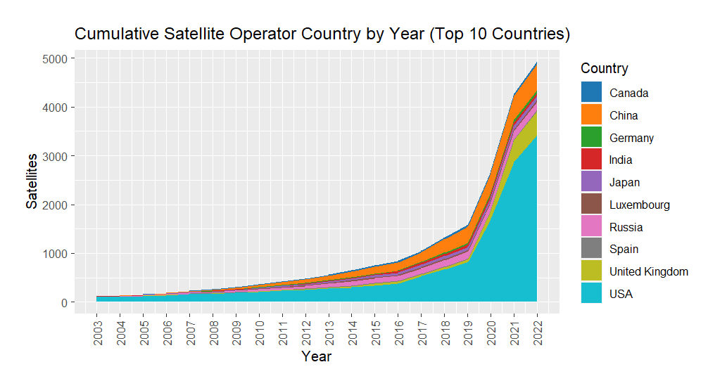
Current trends orbit activity
04/18/2023

Slide 5
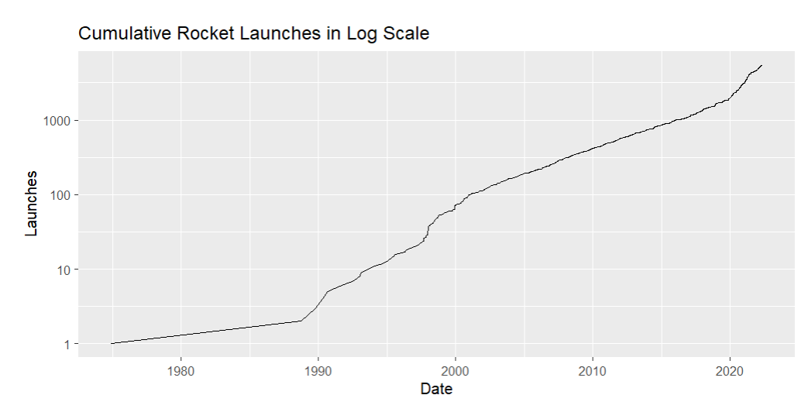
Current trends orbit activity
04/18/2023

Slide 6
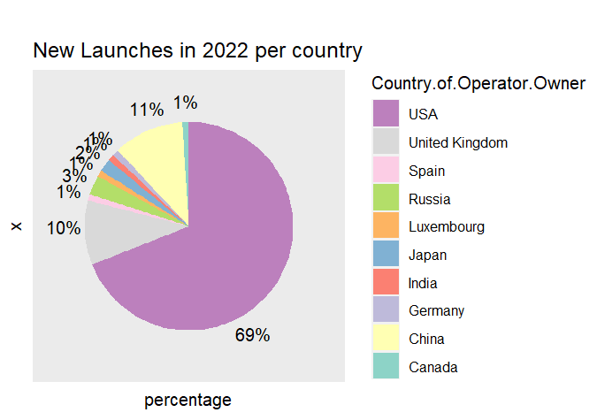
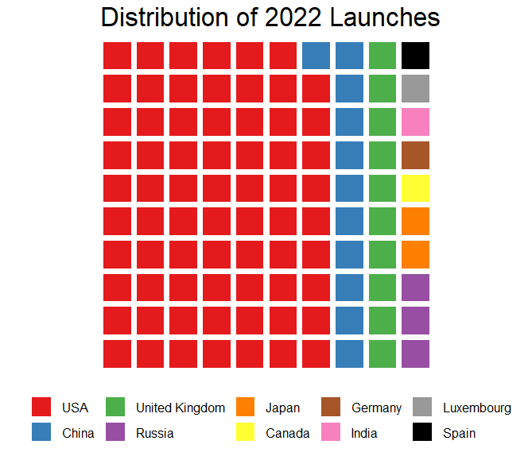
Segmentation of satellite market
04/18/2023

Slide 7
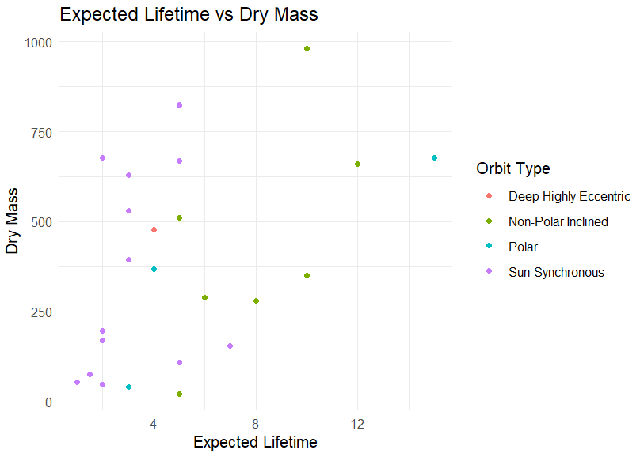
Cluster analysis
04/18/2023

Slide 8
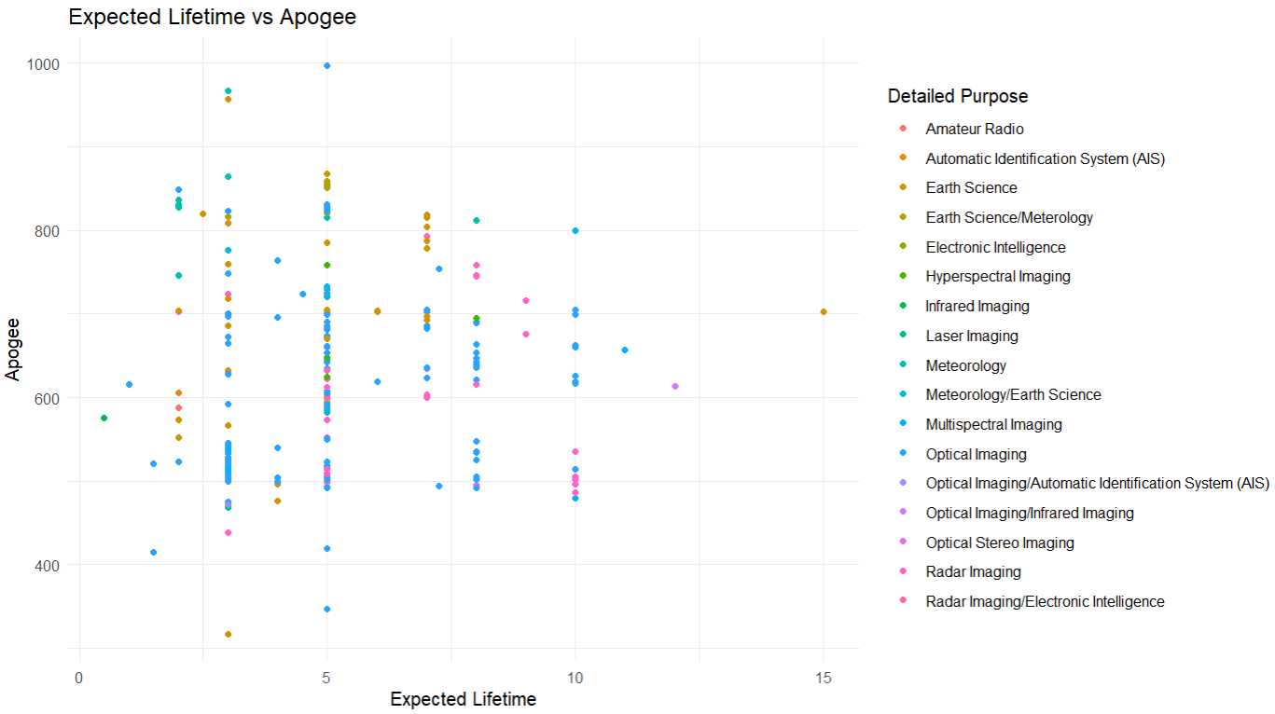
Cluster analysis
04/18/2023

Slide 9
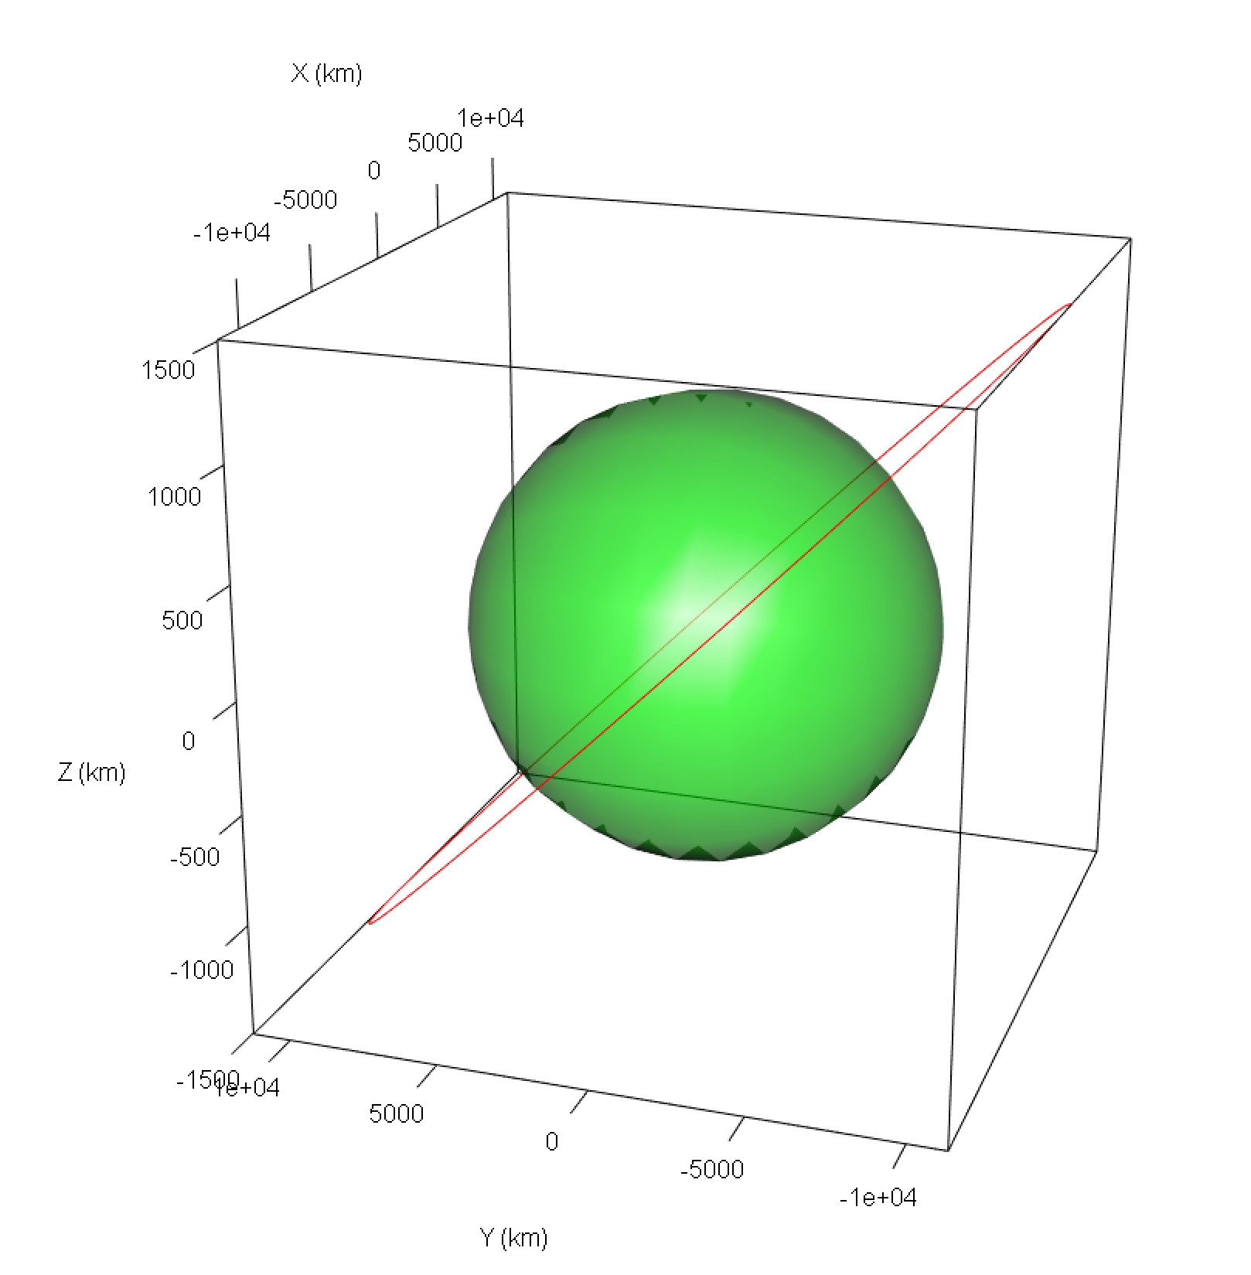
Visualizing Single Orbits
Nominal Path Planning
Trajectory relative to interaction with the earth
Baselining feasibility of launch capability
Segmenting area of interest
04/18/2023

Slide 10
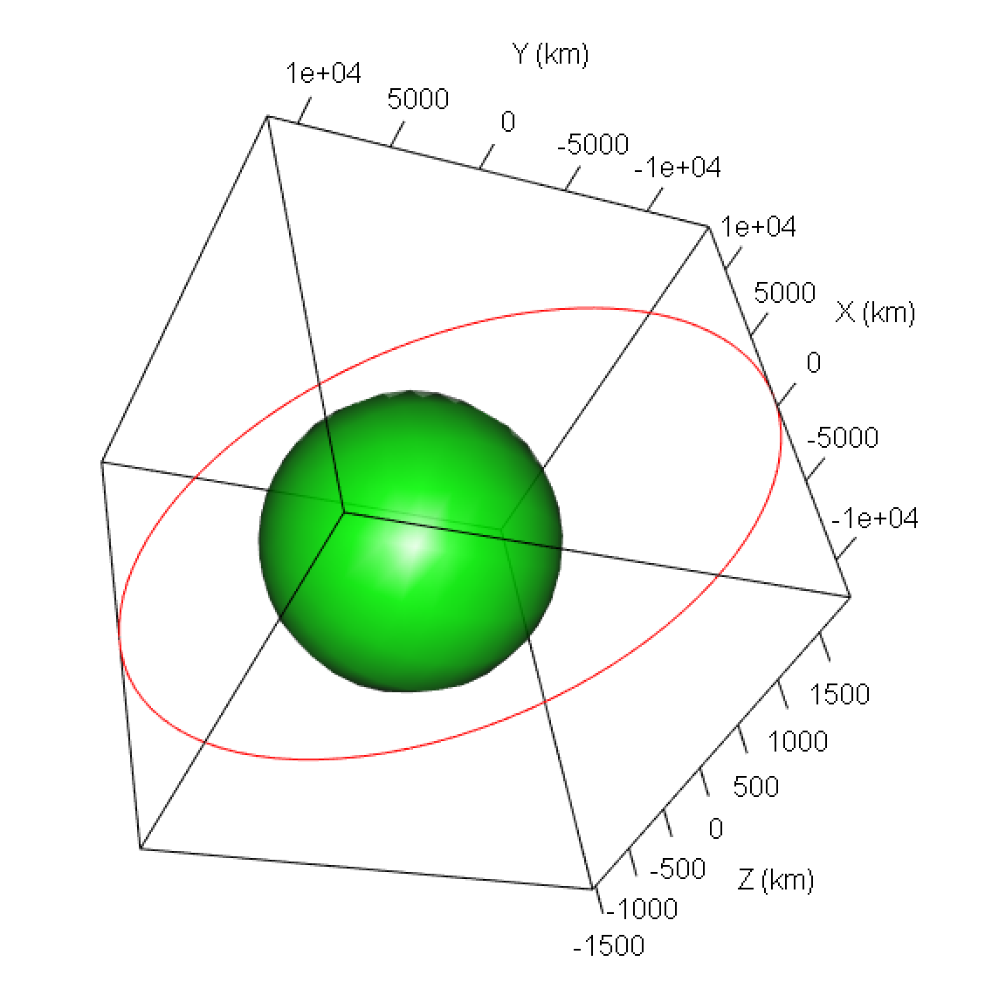
Visualizing Multiple Orbits
Holistic Path Planning
More objects means less feasible paths
Two point collision checking
Sensor coverage visual
04/18/2023

Slide 11
Conclusions
New players appear on the satellite market every year
The number of artificial satellites grows exponentially
Orbital paths around Earth are becoming crowded
Financial and Operational risks should be immediately addressed
04/18/2023

Slide 12
Future Work
Collision Risk Planning
Lifetime Risk Profile
Intelligent path planning
Multi path collisions
Avoidance costs
Numerical risk rating
Coverage planning
Replacement budgeting
04/18/2023

Slide 13
Questions?

